Slide 1
Amazon API Gateway
Manisha Akkapally

Slide 2
What is Amazon API Gateway?
Amazon API Gateway is a fully managed AWS service used to create, publish, secure, and monitor APIs.
It acts as the front door for applications to access backend services.
API Gateway receives client requests, routes them to backend services, and returns the response.

Slide 3
TYPES OF API
Amazon API Gateway supports three types of APIs:
1.REST API
2.HTTP API
3.WebSocket API

Slide 4
REST API
REST API is the most commonly used API type in API Gateway.
It is used to build traditional RESTful services where clients send HTTP requests such as:
GET
POST
PUT
DELETE
Features
Full API management features
Supports API Keys
Supports Usage Plans
Request/Response transformation
Fine-grained security
Works with Lambda, EC2, and HTTP backends

Slide 5
HTTP API
HTTP API is a simpler and lower-cost API type.It is designed for lightweight and high-performance APIs.
Features
Faster than REST API
Lower cost
Simple routing
Supports Lambda and HTTP backends
Built-in JWT / OAuth support

Slide 6
WebSocket API
WebSocket API is used for real-time two-way communication.
Unlike REST and HTTP APIs, WebSocket keeps the connection open between client and server.
Features
Real-time communication
Two-way messaging
Persistent connection
Event-based communication

Slide 7
How API Gateway Works
Client sends a request to the API endpoint.
API Gateway receives the request.
API Gateway routes the request to the backend service.
Backend service processes the request.
API Gateway returns the response to the client.

Slide 8
Key Features
Create and manage REST, HTTP, and WebSocket APIs
Secure APIs using IAM, API Keys, Cognito, and Authorizers
Traffic management with throttling and request limits
Built-in monitoring using CloudWatch
Scalable and fully managed service
Easy integration with AWS services

Slide 9
Use Case Implemented
Built a REST API using Amazon API Gateway
Created resource path: /home
Configured GET method on /home
Integrated API Gateway with AWS Lambda
Lambda function returns: Hello from AWS Lambda!
Deployed API to stage: Deploy

Slide 10
Architecture
Client Request → API Gateway → AWS Lambda → Response
API Gateway acts as the entry point for external requests
Lambda processes the request and returns the response

Slide 11
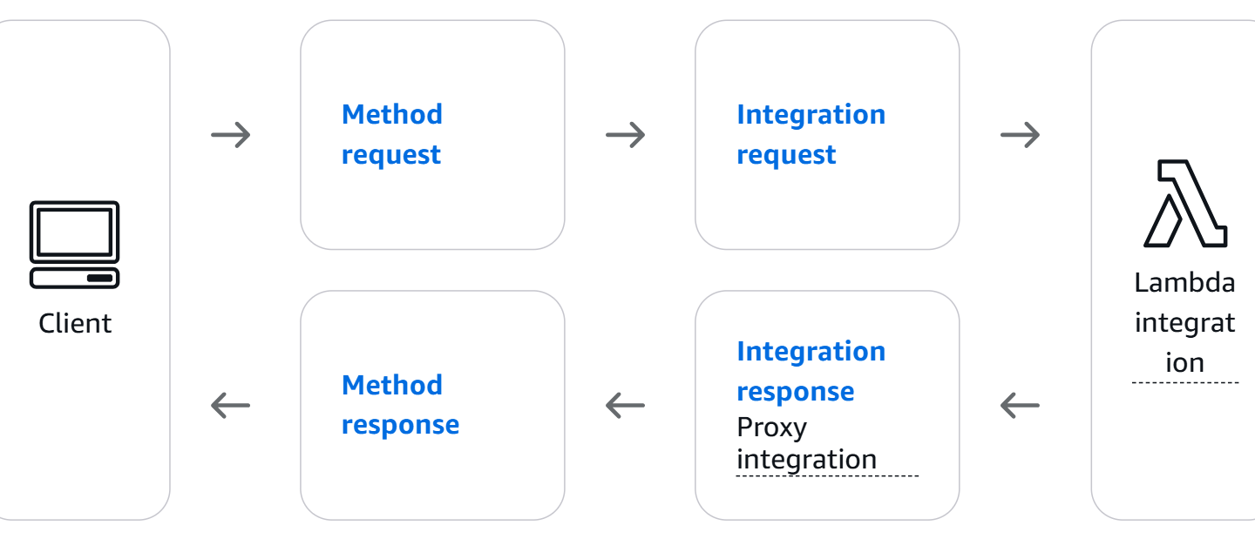
FLOW

Slide 12
Live Execution Flow
Created REST API in API Gateway
Added /home resource
Configured GET method
Integrated Lambda function
Deployed API
Tested endpoint successfully in browser

Slide 13
Tested Endpoint
Invoke URL used:
https://fmjp76t4a1.execute-api.us-east-1.amazonaws.com/Deploy/home
Response received successfully:
Hello from AWS Lambda!

Slide 14
Benefits of API Gateway
Fully managed API service
Secure and scalable
Supports serverless architectures
Easy to integrate with Lambda
Useful for web, mobile, and microservices applications

Slide 15
Conclusion
Amazon API Gateway simplifies API creation and management in AWS
It securely exposes backend services to external clients
In this implementation, API Gateway successfully invoked Lambda and returned the expected response

